Slide 1

SQL for Data Science
Azeez Busari - November 2019

Slide 2
Agenda
Introduction
Introduction to Database
Introduction to Data-warehouse
Introduction to SQL
Database Objects
RDBMS Concepts
SQL Operators, Data types, Expressions , Syntax , Queries (create, insert, update, delete, truncate, drop, and & or clauses, select etc.)

Slide 3
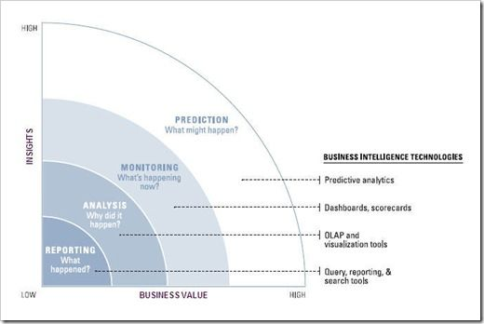
Introduction to Business Analytics (Roadmap)
Business Analytics
Business Intelligence
Data Warehousing
Database(s)

Slide 4
Introduction to Database
A database is an organized collection of data
A database-management system (DBMS) is a computer software that interacts with end-users, other applications, and the database itself to capture and analyze data. A general-purpose DBMS allows the definition, creation, querying, update, and administration of databases.
Well-known DBMSs include MySQL, PostgreSQL, EnterpriseDB, MongoDB, MariaDB, Microsoft SQL Server, Oracle, Sybase, SAP HANA, MemSQL, SQLite and IBM DB2.
Rows/Columns – Records/Fields
Database is a collection of schemas, tables, queries, reports, views, and other elements

Slide 5
Introduction to Data warehousing
A data warehouse is a database designed to enable business intelligence activities: it exists to help users understand and enhance their organization's performance
It is designed for query and analysis rather than for transaction processing, and usually contains historical data derived from transaction data, but can include data from other sources
Data Warehouse helps in:
Maintaining historical records
Analyzing the data to gain a better understanding of the business and to improve the business
In addition to a relational database, a data warehouse environment can include an extraction, transportation, transformation, and loading (ETL) solution, statistical analysis, reporting, data mining capabilities, client analysis tools, and other applications that manage the process of gathering data, transforming it into useful, actionable information, and delivering it to business users.

Slide 6
Introduction to Data warehousing (Cont’d)
Key Characteristics of a Data Warehouse
The key characteristics of a data warehouse are as follows:
Data is structured for simplicity of access and high-speed query performance.
End users are time-sensitive and desire speed-of-thought response times.
Large amounts of historical data are used.
Queries often retrieve large amounts of data, perhaps many thousands of rows.
Both predefined and ad hoc queries are common.
The data load involves multiple sources and transformations.

Slide 7
Introduction to SQL
SQL is a standard language for accessing and manipulating databases
SQL stands for Structured Query Language
What Can SQL do?
SQL can execute queries against a database
SQL can retrieve data from a database
SQL can insert records in a database
SQL can update records in a database
SQL can delete records from a database
SQL can create new databases
SQL can create new tables in a database
SQL can create stored procedures in a database
SQL can create views in a database
SQL can set permissions on tables, procedures, and views etc

Slide 8
Introduction to SQL (Cont’d)
Languages
Database languages are special-purpose languages, which do one or more of the following:
Data definition language – defines data types such as creating, altering, or dropping and the relationships among them
Data manipulation language – performs tasks such as inserting, updating, or deleting data occurrences
Query language – allows searching for information and computing derived information

Slide 9
Introduction to Database Objects
Database objects are the underlying backbone of the relational database
A database object is any defined object in a database that is used to store or reference data. Some examples of database objects include tables, views, functions, procedures, packages, clusters, sequences, indexes, and synonyms
A schema is a collection of database objects associated with one particular database username. This username is called the schema owner, or the owner of the related group of objects. You may have one or multiple schemas in a database. The user is only associated with the schema of the same name and often the terms will be used interchangeably
The table is the primary storage object for data in a relational database. In its simplest form, a table consists of row(s) and column(s), both of which hold the data. A table takes up physical space in a database and can be permanent or temporary.
A database view is a searchable object in a database that is defined by a query. Though a view doesn't store data, some refer to a views as “virtual tables,” you can query a view like you can a table. A view can combine data from two or more table, using joins, and also just contain a subset of information.

Slide 10
Introduction to Database Objects (Cont’d)
A stored function (also called a user function or user-defined function) is a set of PL/SQL statements you can call by name. Stored functions are very similar to procedures, except that a function returns a value to the environment in which it is called.
A procedure is a group of PL/SQL statements that you can call by name. A call specification (sometimes called call spec) declares a Java method or a third-generation language (3GL) routine so that it can be called from SQL and PL/SQL. The call spec tells Oracle Database which Java method to invoke when a call is made.
A package is an encapsulated collection of related procedures, functions, and other program objects stored together in the database. The package specification declares these objects. The package body, specified subsequently, defines these objects
A sequence is a database object from which multiple users may generate unique integers. You can use sequences to automatically generate primary key values
An index is a schema object that contains an entry for each value that appears in the indexed column(s) of the table or cluster and provides direct, fast access to rows. Oracle Database supports several types of index

Slide 11
RDBMS Concepts
RDBMS stands for Relational Database Management System. RDBMS is the basis for SQL, and for all modern database systems like MS SQL Server, IBM DB2, Oracle, MySQL, and Microsoft Access.
A Relational database management system (RDBMS) is a database management system (DBMS) that is based on the relational model as introduced by E. F. Codd.
Data Integrity
The following categories of data integrity exist with each RDBMS −
Entity Integrity − There are no duplicate rows in a table.
Domain Integrity − Enforces valid entries for a given column by restricting the type, the format, or the range of values.
Referential integrity − Rows cannot be deleted, which are used by other records.
User-Defined Integrity − Enforces some specific business rules that do not fall into entity, domain or referential integrity.

Slide 12
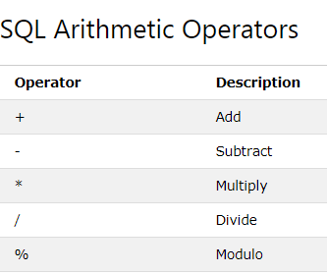
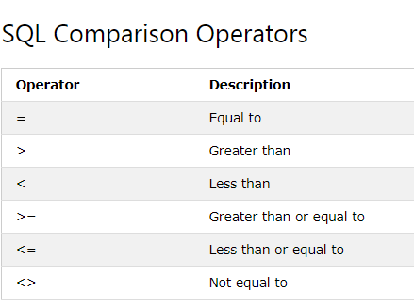
SQL Operators

Slide 13
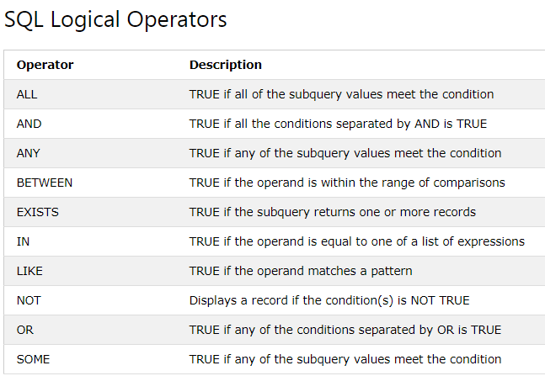
SQL Operators (Cont’d)

Slide 14
Data Types
Date
Dates between January 1, 1000 A.D. and December 31, 9999 A.D. The default format is a 2-digit day, a 3-letter month, and a 4-digit year; for example, 03MAR1997
Number
When you define a NUMBER variable, you can specify its precision (p) and scale (s) so that it is sufficiently, but not unnecessarily, large. Precision is the number of significant digits. Scale can be positive or negative. Positive scale identifies the number of digits to the right of the decimal point; negative scale identifies the number of digits to the left of the decimal point that can be rounded up or down.
Char
The CHAR data type accepts character strings, including Unicode, of a fixed length. The length of the character string should be specified in the data type declaration; for example, CHAR(n) where n represents the desired length of the character string. If no length is specified during the declaration, the default length is 1.
Varchar2
The VARCHAR data type accepts character strings, including Unicode, of a variable length is up to the maximum length specified in the data type declaration.
A VARCHAR declaration must include a positive integer in parentheses to define the maximum allowable character string length. For example, VARCHAR(n) can accept any length of character string up to n characters in length. The length parameter may take any value from 1 to the current table page size. Attempting to assign a value containing more characters than the defined maximum length results in the truncation of the character string to the defined length. If any of the truncated characters are not blank, an error is raised.
NOTE: VARCHAR(0) is not allowed and raises an exception.

Slide 15
Expressions
An expression is a combination of one or more values, operators and SQL functions that evaluate to a value. They are like formulae and they are written in query language. You can also use them to query the database for a specific set of data . There are three types of SQL expressions:
Boolean Expressions:
SQL Boolean Expressions fetch the data based on matching a single value. An example is this:
Select * from customers where salary=10000.
This returns only those customers whose salary meets the condition of being true, i.e, the salary is equal to 10000.
Numeric Expressions:
These expressions are used to perform any mathematical operation in any query. An example is:
Select salary*20 from customers.
This multiplies the salary of each customer in the table by 20.
Date Expressions:
Date Expressions return current system date and time values . An example is:
Select sysdate from dual;
This returns the current system date and time.

Slide 16
Syntax
These are the unique set of rules and guidelines that are used to write SQL . All SQL statements starts with any of the keywords:select,update,insert,delete,alter,drop,create and end with a semicolon(;).SQL keywords are not case sensitive.
Some examples include:
Select column1,column2…,columnN from tablename;
Select column1,column2…,columnN from tablename where condition;

Slide 17
SQL Queries
These are the statements that are used to perfrom actions on a database. Some of these actions include:
Create
Insert
Update
Delete
Truncate
Drop
And $ Or Clause
Select.
Select
This is used to fetch records from a table.The basic syntax is:
Select * from tablename;
Create
This is used to create an object in a database. Objects that can be created include tables,views,sequence,database.The syntax to create a table is:

Slide 18
SQL Queries
Create table tablename(column1 datatype,
Column2 datatype,
column3 datatype,
……..,
columnN datatype,
Primary key(one or more columns));
Insert
This is used to insert a values/values into a table. The syntax is:
Insert into tablename(column1,column2,column3,…….columnN)
Values (value1,value2,value3,…..,valueN);
Update
This is used to change the values of a table. The syntax is:
update table_name
setcolumn1 = value1, column2 = value2....columnN=valueN
[ where condition];

Slide 19
SQL Queries
Delete
This is used to delete the records of a table when a condition is satisfied . The syntax is:
Delete from tablename
Where {condition};
Truncate
This is used to delete all the records of a table without deleting the table structure . It is used to empty a table . The syntax is:
Truncate table tablename;
Drop
This is used to delete and completely remove an object( table, index, sequence, database, view, procedure etc) from a database.
This removes the contents of the objects as well as the structure. The syntax is:
Drop object objectname;
For example, to drop a table named customer, run the query : drop table customer;

Slide 20
SQL Queries
And / Or clause:
This is used to perform an action on a table that satisfies more than one condition.The OR clause is used when either of one or
more condition is to be satisfied.An example for the and clause is:
Select column1,column2…,column
From tablename
Where condition1=value
and condition2=value;
This will return records from the table that meet the two conditions given.
Select column1,column2…,column
From tablename
Where condition1=value
or condition2=value;
This will return records from th table that meet either of the two conditions given.

Slide 21
CONTACT
Azeez Busari
Bluechip Technologies Limited
M;+234 810 108 3974
E: abusari@bluechiptech.biz
W: www.bluechiptech.biz
Address: Plot 9b Onikoyi lane, Ikoyi

Slide 22

THANK
YOU
www.bluechiptech.biz

